Slide 1




AMAZON
SALES ANALYSIS USING SQL
presented by
Parul Kokcha

Slide 2

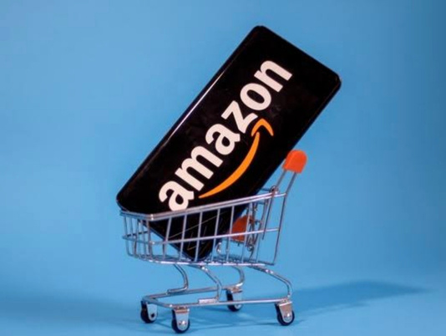


INTRODUCTION
Founded in 1994 by Jeff Bezos in Bellevue, Washington,[6] the company originally started as an online marketplace for books but gradually expanded its offerings to include a wide range of product categories, referred to as "The Everything Store".[7] Today, Amazon is considered one of the Big Five American technology companies.
02

Slide 3


PROBLEM STATEMENT
You are working at Amazon, a leading e-commerce platform. The management has tasked you with analyzing sales data by performing different queries in sql.
03

Slide 4

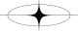

QUESTIONS
LIST ALL PRODUCTS WITH A DISCOUNTED PRICE BELOW ₹500.
FIND PRODUCTS WITH A DISCOUNT PERCENTAGE OF 50% OR MORE.
RETRIEVE ALL PRODUCTS WHERE THE NAME CONTAINS THE WORD "CABLE."
DISPLAY THE DIFFERENCE BETWEEN THE AVERAGE OF THE ACTUAL PRICE AND THE DISCOUNTED PRICE FOR EACH PRODUCT.
QUERY REVIEWS THAT MENTION "FAST CHARGING" IN THEIR CONTENT.
04

Slide 5
QUESTIONS
LIST IDENTIFY PRODUCTS WITH A DISCOUNT PERCENTAGE BETWEEN 20% AND 40%.
FIND PRODUCTS THAT HAVE AN ACTUAL PRICE ABOVE ₹1,000 AND ARE RATED 4 STARS OR ABOVE.
FIND PRODUCTS WHERE THE DISCOUNTED PRICE ENDS WITH A 9
DISPLAY REVIEW CONTENTS THAT CONTAINS WORDS LIKE WORST, WASTE, POOR, OR NOT GOOD.
LIST ALL PRODUCTS WHERE THE CATEGORY INCLUDES "ACCESSORIES."
05

Slide 6


List all products with a discounted price below ₹500.
06

Slide 7
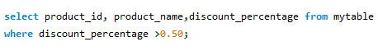

Find products with a discount percentage of 50% or more.
07

Slide 8
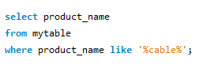
Retrieve all products where the name contains the word "Cable."
08

Slide 9
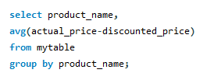
Display the difference between the average of the actual price and the discounted price for each product.
09

Slide 10
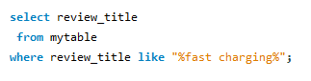
Query reviews that mention "fast charging"
in their content.
10

Slide 11
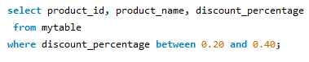
Identify products with a discount
percentage between 20% and 40%.
11

Slide 12
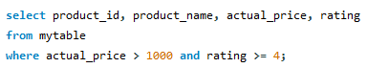
Find products that have an actual
price above ₹1,000 and are rated
4 stars or above.
12

Slide 13
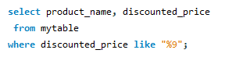
Find products where the discounted
price ends with a 9
13

Slide 14
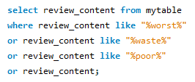
Display review contents that
contains words like worst,
waste, poor, or not good.
14

Slide 15
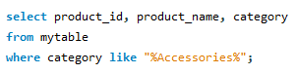
List all products where the
category includes "Accessories."
15

Slide 16


Phone number
+9187xxxxxxxx
Email
nonieverma1994@gmail.com
Linkedin
https://www.linkedin.com/in/parul-kokcha-7852482a1/
CONTACT US
16

Slide 17

THANKS
17
Thank you for your attention to our sales report presentation. If you have any questions or would like to discuss the findings in more detail, please don't hesitate to reach out to our sales team. We appreciate your continued support and partnership.

